Slide 1
Information Session
Open Textbook Equity Adaptation Call for Proposals
Resources: bit.ly/infoequityadapt
Josie Gray (she/her)
BCcampus
jgray@bccampus.ca
April 28, 2023
Kaitlyn Zheng (she/her)
BCcampus
kqzheng@bccampus.ca
Notes:
Hello everyone! Thank you for taking the time out of your day to attend this info session where we explore the open textbook equity adaptation call for proposals. I really appreciate your interest in this project, and my hope is that this session will give you all the information you need to submit a great proposal.
The first part of the session is being recorded. As long as you don't unmute, you won't appear in the recording. When it comes time for questions, we will stop the recording.
My colleague Kaitlyn Zheng has worked with me on preparing these call for proposals and she is in the session today monitoring the chat, so please do use the chat and watch there for her to share links to different resources.
There is a link on the slide that will take you to a folder where you can download a copy of these slides as well as a document with links to all of the materials related to this call for proposals. You can access this folder at https://bit.ly/infoequityadapt. Kaitlyn will also put this link directly into the chat.

Slide 2
My Positionality
Notes:
I am the project manager for the two grants that we are going to talk about today, so I wanted to share a bit of information about me and my positionality. My name is Josie Gray. My pronouns are she/her. I am a white non-disabled bisexual cis woman in my late twenties. I have shoulder length, light-coloured hair, glasses, and a septum piercing.
I have worked at BCcampus for over six years. In my role, I oversee the B.C. Open Collection, which is a collection of over 350 open textbooks and open courses. I also manage a small team that supports faculty and staff in B.C. use, create, and adapt open educational resources. As such, I know a lot about everything that goes into creating and adapting open educational resources. This includes a lot of knowledge and experience around creating digital educational materials that are accessible for disabled students.
I have a Masters of Design in Inclusive Design from OCAD University in Toronto. As part of my master's work, I produced a podcast that looked at knowledge justice and knowledge equity in the context of open education. So I have a strong interest and commitment to equity in open education that I am bringing into this project.
I am a settler of mixed European ancestry, and my family and ancestors have lived uninvited on the lands of Indigenous Peoples across so called North America for over 150 years. I grew up on Tsimshian territory on the northwest cost in BC, and I spent nearly 10 years on the territories of the lək̓ʷəŋən Peoples, known today as the Songhees and Esquimalt Nations, and the territories of the W̱SÁNEĆ Peoples, which is where I completed my undergraduate and masters education, as well as started my work in open education. I am very grateful for the time I’ve spent living and learning in each of these places.
I am joining you all today from Moh’kins’tsis, which is the area that is now the city of Calgary and part of Treaty Seven. The Peoples that are part of Treaty 7 include the Blackfoot, the Tsuut’ina Nation, and the Stoney Nakoda. I have only lived here since August, so I am still very new to these lands but grateful to be here.
As a settler, acknowledging the lands and Indigenous nations is important to me because this country was built on genocide and violence that continues to this day, and as a settler I have a responsibility to not turn away from that fact, and I see land acknowledgements as a way to hold myself accountable to action beyond just acknowledging the land. Also, land acknowledgements are a regular practice that give me space to reflect and learn about the lands I live on and the Peoples who continue to care for these lands.
I share all of these things so explicitly because I believe that education is always political, and our politics and positionality always influence how we teach, design, and understand the world. Ignoring those things does not make our work better. I believe that equity in education doesn’t happen by accident. It requires intention, care, and the willingness to listen and learn, and those are all things that I aim to bring forward in this project.

Slide 3
Session Overview
About the project
How we will evaluate proposals
Questions
Connect with possible collaborators

Slide 4
About BCcampus
Our mandate is to provide teaching, learning, educational technology, and open education support to the post-secondary institutions of British Columbia. We accomplish this through collaborative leadership that brings innovative resources and effective expertise together to create awareness, understanding, and adoption of openly available curricular resources. Ultimately, our goal is to improve student learning.
Notes:
For anyone here that might not be familiar with BCcampus, we are a provincial organization
Funded by the Ministry of Post-Secondary Education and Future Skills
Three areas of practice: Open Education, Learning and Teaching, and Collaborative Projects
The Open Education team also receives funding from the Hewlett Foundation, which is where the funding for this project is coming from.
Our mandate is to provide teaching, learning, educational technology, and open education support to the post-secondary institutions of British Columbia. We accomplish this through collaborative leadership that brings innovative resources and effective expertise together to create awareness, understanding, and adoption of openly available curricular resources. Ultimately, our goal is to improve student learning.

Slide 5
About the Project
Goal: Update and revise the content and approach of the textbook to be more equitable and inclusive.
Notes:
So the goal for this project is to take two open textbooks that are well adopted in BC and adapt them with the goal of making the content and approach of the textbook more equitable and inclusive.
This is our first time doing something a project like this at BCcampus, so it's an opportunity to try things and learn.
One of the big things we are hoping to see with this project is a collaborative approach to ensure a diversity of perspectives. That's why we are looking for people to apply as a team, rather than as individuals.

Slide 6
What do we mean by equity?
Accessible design
Student centred
Inclusive language
Representation of diversity
Incorporation of Indigenous pedagogies
Diversity of knowledge and expertise within the field of study
Informed by frameworks like
Disability justice
Anti-racism
Decolonization
Feminism
Intersectionality
Epistemic justice
Notes:
Now equity is a broad concept that encompasses a lot of different things. So I wanted to talk a little bit more concretely about what we mean when we talk about equity in this project.
It includes:
Accessible and student centred design
Inclusive language
Representation of diversity
Incorporation of Indigenous pedagogies
Diversity of knowledge and expertise within the field of study
And these things are informed by frameworks like disability justice, anti-racism, decolonization, feminist, intersectionality, epistemic justice, etc.
Now that’s a lot, and this is a project with a set amount of funding and a set deadline. We are not expecting that by the end of the project you will have produced a 100% perfectly inclusive textbook. Instead in the application we will be looking for your vision of what you hope to accomplish with the funding and what values and frameworks will be informing your approach.
My colleague Kaitlyn will drop a link to the OER Equity Rubric in the chat, which goes into a lot more information about how we are thinking about equity in the context of open educational resources.

Slide 7
Textbooks to Adapt
Notes:
So there are two call for proposals open right now. One for each of the open textbooks that are posted on the screen.
Introduction to Psychology, 1st Canadian Edition was adapted by Jennifer Walinga in 2014 from an American open textbook published in 2010. The adaption focused on revising the book to make it relevant for Canadian post-secondary students.
Since 2014 this book has been adopted by B.C. faculty in more than 200 psychology courses and has saved students $810,000. This book has not been meaningfully updated since 2014, so it’s quite out of date.
Introduction to Sociology has been adopted by B.C. faculty in more than 275 sociology courses and has saved students over $1.4 million since 2015. The book was adapted by William Little in 2015 from OpenStax’s Introduction to Sociology. The adaption focused on revising the book to make it relevant for Canadian post-secondary students. William Little published a second Canadian edition in 2016 and is nearly finished a third Canadian edition that will be adapted through this grant. So for those interested in adaptation this book, you will see that on the call for proposals page you can view a draft of the third edition as a PDF, which is a better representation of the version of the book that you would be adapting that the 2nd edition from 2016. The 3rd edition will be completed by the time this project gets going.
So because one of these books is very recently updated while the other one hasn’t been updated for nearly 10 years, we are expecting significant differences in what each project will accomplish. It also means that there is a little bit more funding available for the Introduction to Psychology text.

Slide 8
What might adaptation look like?
Editing
Rewriting
Reframing
Removing
Adding
Transforming
Notes:
With an adaptation project, you have the ability to take the existing content and make changes. This can include
Editing content by changing names or language
Rewriting sections or chapters
Reframing the discussion of a particular topic
Removing content that is no longer relevant or reducing the length of chapters
Adding new examples, images, references, and points of view
Transforming text into multimedia

Slide 9
Support Provided by BCcampus
Grant funding ($20k for Psych; $17.5K for Socio)
Access to a curriculum equity consultant with instructional design expertise
Training and ongoing technical support on accessible publishing, open licensing, and Pressbooks
Copyediting when the project is complete
Notes:
So this is the support that BCcampus is able to provide for this project:
There is direct funding available, $20 thousand for Introduction to psychology open textbook and $17,500 for the Introduction to Sociology open textbook.
In addition, each project team will have access to a curriculum equity consultant who has instructional design expertise and has worked on open projects with BCcampus in the past
BCcampus will also provide training around accessible publishing, open licencing, and Pressbooks, the publishing tool these projects will use. We will be available to support these things throughout the project.
And then when the project is done, BCcampus will also pay to have the books copyedited.

Slide 10
What the Funding Can be Used For
To pay contributors for their time
To pay for services (i.e., graphic designers, narrators)
To hire students
To get course/time release
Notes:
We are pretty flexible about what the funding can be used for. Most often, grant funds are used to:
Directly pay contributors for their time
To pay for services like graphic design, animation, audio book production, or video editing
To hire students
To get course/time release

Slide 11
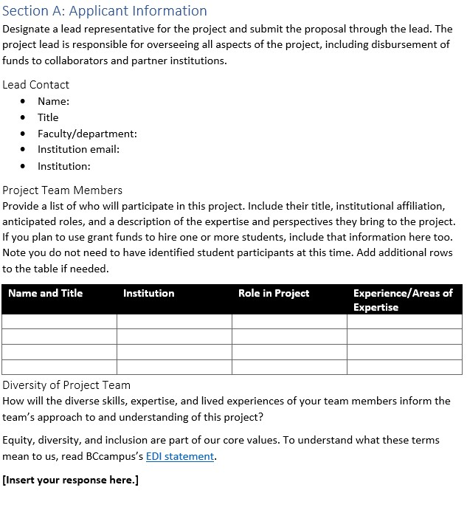
Application
Applicant Information
Project Proposal
Budget
Notes:
The application is a Word document divided into a number of sections, with placeholders for where you can enter in your responses. The main parts of the application are:
Applicant information – so info about the project team
The Project proposal – so an overview of your intentions and plan for the project
And a budget.
One thing to note with the application is that you must identify a lead for the project. It will be their responsibility for overseeing the project and communicating directly with BCcampus. This may also include distributing funds to collaborators and partner institutions, depending on how the contracts are set up.
I won’t go into more detail about the application template since it aligns really closely with the rubric that will be used to evaluate application, which I will go through in a lot of detail in a few slides. Kaitlyn will put a link to the rubric in the chat, and I encourage you to read through it all before you start working on it.

Slide 12
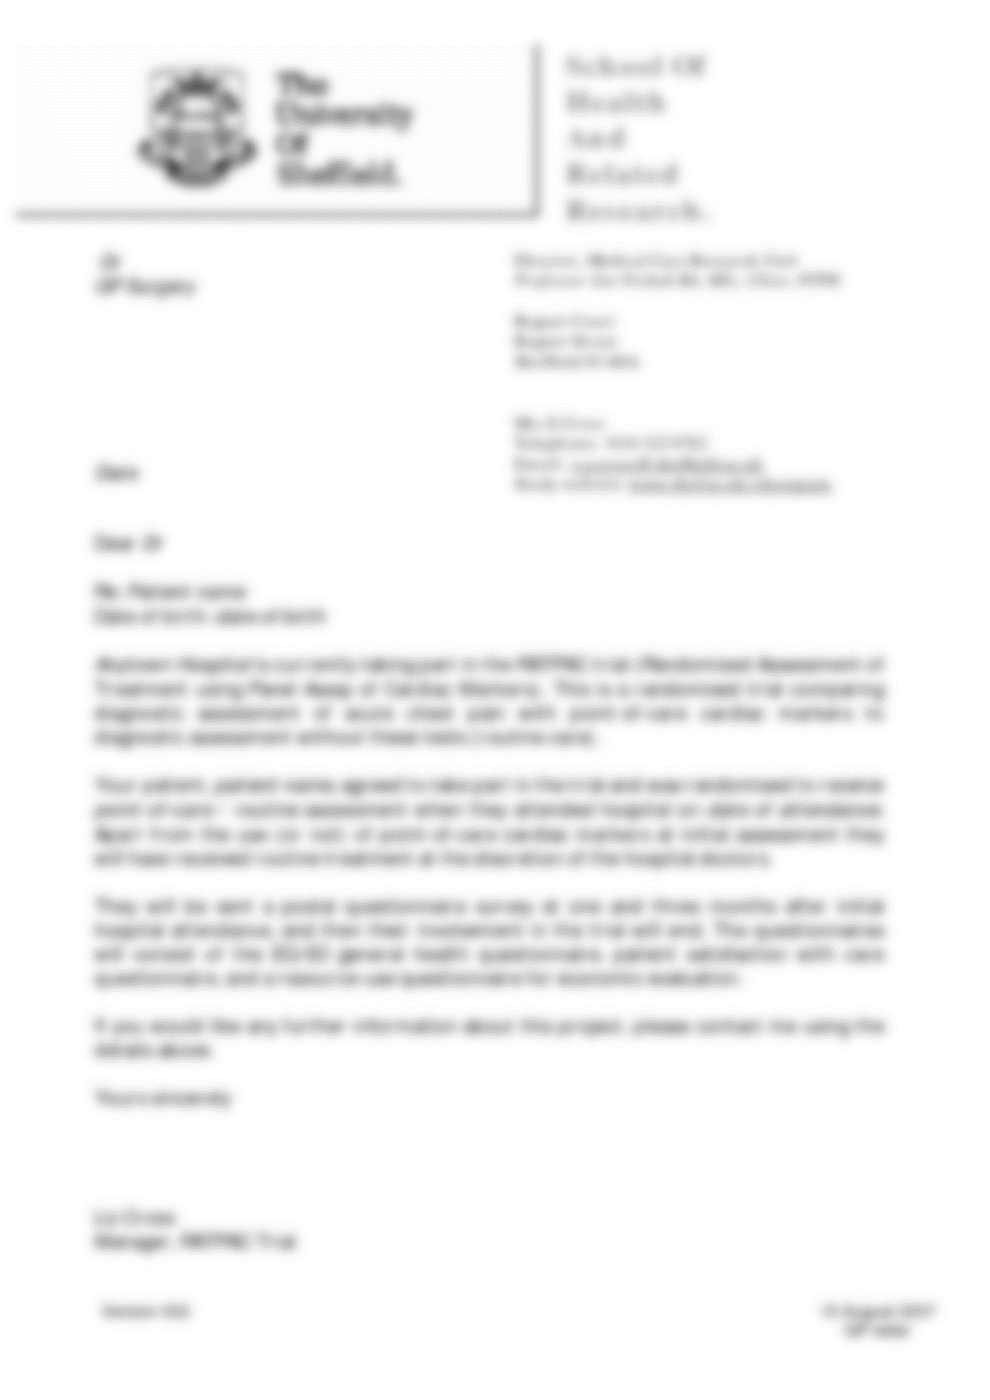
Letter of Support
The letter of support should
Be written by someone in a leadership position at your institution
Communicate their support for you taking on this project
Describe any additional supports the institution is providing (not required)
This Photo by Unknown Author is licensed under CC BY-SA
Notes:
In addition to the application, every submission needs to include a letter of support. The letter of support should be from someone in a leadership position, such as a department head, director, or dean. The letter is just to say that they support you doing this project. In addition, if they are able to provide additional funds or in-kind services, they should mention those in this letter. This is not required, but it would strengthen your application.
If your team has multiple institutions involved, you will need one letter of support for each institution.

Slide 13
What Makes a Strong Proposals
The proposal review committee will look for:
A diverse team with the needed skills and experience
A clear vision for the project
A high-level workplan that centres collaboration and describes how the vision will be achieved
A realistic and easy-to-understand timeline and budget
Notes:
So let’s talk about what will make a strong proposal. Overall, the proposal review committee will be looking for:
A diverse team with the needed skills and experience
A clear vision for the project
A high-level workplan that centres collaboration and describes how the vision will be achieved
A realistic and easy-to-understand timeline and budget
But let’s get into a little big more detail about the specifics.

Slide 14
Rubric
Team Makeup (40%)
Roles and experience
Individual diversity
Institutional diversity
Project Plan (60%)
Vision and goals
Workplan
Timeline
Budget
Notes:
The proposal review committee will be using a rubric to evaluate submitted applications. The rubric is posted on the call for proposals page, so it is something you can read for yourself and Kaitlyn will put a link in the chat.
It’s divided into two sections, the makup of the team, which is 40%, and Project plan, which is 60%.

Slide 15
Team Makeup: Roles and Experience (20%)
The roles and experience of each team member is clear. Team members bring knowledge related to:
Subject matter
Indigenous pedagogies and ways of knowing
Equity, diversity, and inclusion
Accessibility and Universal Design for Learning
Student experience
Notes:
So 20% of the team makeup score will be looking at the roles and experience of the team. We are really wanting these projects to have people who have the knowledge and experience to do this work well. So this can include subject matter expertise in the field of study, as well as knowledge related to Indigenous pedagogies and ways of knowing, equity diversity and inclusion, accessibility and universal design for learning, and the student experience, and totally recognizing that one person may have knowledge across more than one of these areas.

Slide 16
Possible Roles
Project lead
Writers/adapters
Consultants
Editors (Content editors, technical editors
Reviewers (peer reviewers and student reviewers)
Researchers
Media developers
Notes:
Related to the experience people are bringing is the role they will play in the project. Possible roles people might have are
Project lead
Writers and adapters
Consultants
Editors (content editors and technical editors)
Reviewers (peer reviewers and student reviewers)
Researchers
Media developers

Slide 17
Team Makeup: Diversity (20%)
Individual Diversity: The team is made up of people with a variety of lived experiences, perspectives, and identities.
Institutional Diversity: People from different roles and institutions, including rural/remote institutions.
Notes:
The other part of the team makeup score is the team diversity. For this we are looking at two things that we’ve termed the individual diversity and institutional diversity.
For individual diversity, we would like to see teams that are made up of people with a variety of lived experiences, perspectives, and identities. So that includes but is not limited to race, ethnicity, colour, ancestry, place of origin, religion, marital and family status, disability, sex, gender identity and expression, sexual orientation, age, and socioeconomic status.
For institutional diversity, we would like to see that your team includes people from different institutional roles, including students. In addition, although it’s not required, we would like to see applications with representation from more than one institution, including rural and remote institutions.

Slide 18
Project Plan: Vision and Goals (20%)
Tell us
Why the project team would like to adapt this textbook
The values and/or priorities that will guide the project team’s approach to the adaptation
The impact the project team hopes this adaptation will have on the students and instructors who use this book in the future
Notes:
Next is the project plan. The first part of the project plan is around vision and goals. So in this section, tell us
Why the project team would like to adapt this textbook
The values and/or priorities that will guide the project team’s approach to the adaptation
The impact the project team hopes this adaptation will have on the students and instructors who use this book in the future

Slide 19
Project Plan: Workplan (20%)
Provide a high-level overview of the work by describing key activities or stages of the project.
We are looking for
A workplan that aligns with the described vision
A workplan that prioritizes collaboration and meaningful engagement across the team
Notes:
Then there is the actional workplan for the project. Here, we will be looking for a high-level overview of the work by describing key activities or stages of the project.
So we will be looking for a workplan that aligns with the described vision and a workplan that prioritizes collaboration and meaningful engagement across the team.

Slide 20
Project Plan: Timeline and Budget (20%)
The timeline is realistic and specific, accounts for all the work described, and allows for all work to be completed by March 31, 2024.
The budget is easy to understand. It clearly outlines all direct and in-kind costs and when those costs are expected to occur. Team members are paid fairly for their expected contributions
Notes:
And then the last part of the rubric is related to timeline and budget.
So for timeline, we are looking for it to be realistic and specfic, to see that it accounts for all work described in the work plan, and allows for all work to be completed by March 1, 2024.
For the budget, we would like it to be easy for us to understand and to outline direct and in-kind costs and when those costs are expected to occur. We are also looking to see if team members are paid fairly for their expected contributions.

Slide 21
Resources
OER Equity Rubric [PDF]
Guiding Questions: Creating Equitable OER with Intention
Who Gets to Wield Academic Mjolnir?: On Worthiness, Knowledge Curation, and Using the Power of the People to Diversify OER
Inclusive Pedagogies
Post-Secondary Directory – OpenEd contacts
Notes:
If you are looking for more resources related to equity in education and educational materials, Kaitlyn and I have compiled a few links to explore. These links are included in the document of links that we shared at the beginning of the presentation, and I will get Kaitlyn to but a link to that folder in the chat again.
So the first is the OER Equity Rubric, which I mentioned previously, that outlines the different ways BCcampus is thinking about equity in OER.
Then there is a collection of guiding questions to help think through how to create equitable OER with intention.
The next is an article that talks about an instructor's project to adapt a different Psychology open textbook to make it more equitable. In the article, she describes a crowdsourcing approach she tool.
The next is an OER created by people at KPU that describes inclusive pedagogies.
And finally, there is the post-secondary directory, which is a resource that outlines all of the open education work happening at different institutions in the province. If you are looking for support related to open education at your institution, you will be able to find more information in that resource.

Slide 22
Questions? bit.ly/infoequityadapt
Notes:
And with that, I'd like to open it up to questions. Stop recording

