Slide 1
A Story of Ungrading: Reflections from an Ungraded Classroom BCcampus FLO Friday Oct 20, 2023
Claire Hay, M.Sc. (she/her) Teaching and Learning Specialist (Curriculum and Assessment)
University of the Fraser Valley
"PowerPoint presentation - A Story of Ungrading: Reflections from an ungraded classroom" by Claire Hay, is licensed under CC BY-NC 4.0
Notes:
Ey Swayel. My name is Claire Hay and I am a Teaching and Learning Specialist (Curriculum and Assessment) at the University of the Fraser Valley in Abbotsford, BC. I am a geographer by training and have taught at UFV since 2002 in the Geography program. I moved to a position in our Teaching and Learning Centre in 2020. I still teach as a sessional instructor in my old department from time to time. In Fall 2022 I taught in my first ungraded classroom. My reflections around this experience for the basis for this session.

Slide 2
Acknowledging the land
Notes:
I am joining you today from Stó:lō Temexw, the Sacred Land of the Stó:lō people here in Abbotsford, BC. The Stó:lō people speak Halq'eméylem and have been stewards of this land since time immemorial. I am grateful for the opportunity to learn and work in the beautiful Fraser Valley and to honour the past, present and future stewards of this land.
In Fall 2022 I undertook my 1st ungraded classroom. I also conducted a SOTL research project (with my colleague Victoria Surtees) in this class to better understand how students responded to the ungrading approach. While the study is small it gave me much food for thought and I will share those insights with you throughout this session.

Slide 3
Shape of the session
An interactive warm up activity – grab your phones
Ungrading Basics
My ungrading story
Student insights
Activity – conversation or quiet thinking time
Q&A
Notes:
A note about using the chat. Feel free to use the chat during the presentation to share thoughts and ideas. I always find this a useful resource during online presentations.
For questions, I ask that we use the time I have set aside at the end of the session for questions. If you have a question in mind, drop it in the chat and Paula and Gwen will moderate that for me. I don’t want you to lose that thought. During the Q&A time, we will catch up on questions in the chat or you can use the Raise your Hand button in reactions to show that you have a question. Thanks for your consideration to help keep me on track.
First of all, what this session is not. It is not a comprehensive review of all things ungrading. For that, I would direct you to books by Susan Blum (2020) and Jesse Stommel (2023) as well as the many blog posts and articles that exist on this topic. I have created a resource guide to support this session that has lots of places to expand your learning. Instead, this session is a personal reflection on how I adopted ungrading in my classroom. In this session I will share the what, why and how of my ungrading experiences together with thoughts and reflections of both my students and myself. In doing so, I hope to spark some personal reflection on the decisions you are making in the classroom around assessment and what you might do differently.

Slide 4
A warm-up activity
Go to menti.com
Enter code: 6406 2484
Or use this QR code:
Notes:
Make a few comments on what we see in the results. Ask if anyone would like to comment. Use the Raise Your Hand button.

Slide 5
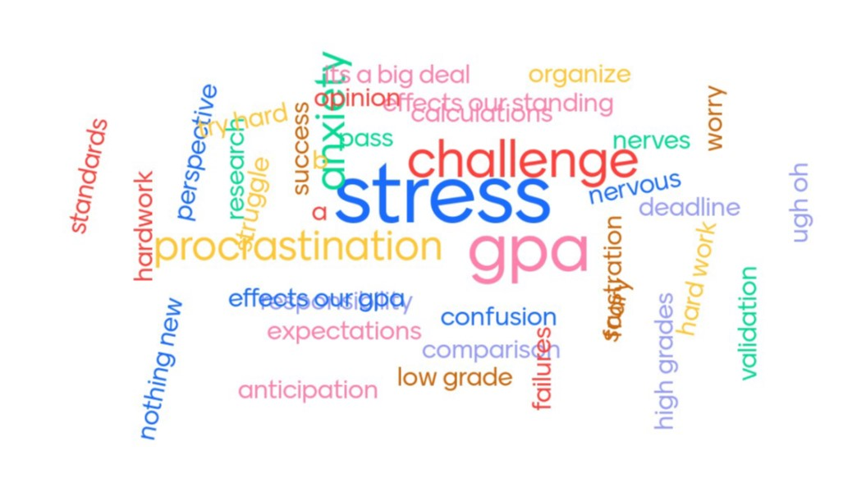

Slide 6
What is ungrading?
“The word ‘ungrading’ means raising an eyebrow at grades as a systemic practice, distinct from simply ‘not grading.’ The word is a present participle, an ongoing process, not a static set of practices. Ungrading is a systemic critique, a series of conversations idally drawing students into those conversations with the goal of engaging them as full agents in their own education. For me, there aren’t a discrete set of best practices for ungrading, because different students learn in different ways at different times with different teachers in different disciplines at different institutions. So, the work of teaching, the work of reimagining assessment, is necessarily idiosyncratic.” (p. 6)
Jesse Stommel. 2023. Undoing the Grade: Why we grade, and how to stop. Hybrid Pedagogy, Denver, CO.

Slide 7
What is ungrading?
I see ungrading as a critical pedagogical approach that centres students in the learning process, disrupts the status quo and tries to counter the many inequities in higher education. It challenges the idea that grades are a valid measure of learning.
Blum (2020 and 2022) sees ungrading as an umbrella term for a variety of approaches and practices:
Process letters
Portfolios
Student self-assessment
Peer assessment
Jesse Stommel (2023 pers. com) suggests that it is the conversation around inequities in higher ed rather than the grading practices themselves that are most important.
Notes:
I want to provide you with a very brief description of ungrading to provide context this presentation which is focused on my insights and reflections of an ungraded classroom. I won’t be talking in detail about all the ins and outs of ungrading, different approaches, theoretical considerations etc. I encourage you to check out the resources in the accompanying resource guide.
Ungrading is a critical approach. Critical in the fact that it challenges the status quo in higher education and centres students wellbeing and learning. It attempts to counter the many inequities that exist in higher education. And It disrupts the notion that grades are a valid measure of student learning.
Blum (2022) considers Ungrading to be an umbrella term for a variety of approaches and practices. Others argue that in means a specific type of approach.

Slide 8
Why ungrading? (from Blum, 2020 and others)
Emphasize intrinsic motivation
Reduce anxiety over grades
Reduce fixation on grades that leads to cheating and other behaviours
Challenge the factory model of education
Avoid ranking and sorting students
Notes:
There are many reasons for ungrading. In the edited book, “Ungrading: Why rating students undermines learning (and what to do instead)“ Susan Blum outlines many of these reasons. Ungrading emphasizes intrinsic motivation, it reduces anxiety of grades, it reduces fixation on grades that leads to cheating and other behaviours, it challenges the banking model of education and avoids ranking and sorting students.
Again, much could be discussed about each of these reasons but I am providing these to give context to the conversation today.

Slide 9
Why did I adopt ungrading?
Notes:
I started my higher ed teaching career in 2002, straight out of grad school where I taught using the same strategies I had experienced as a student. About 10 years in, I started to question what I was doing in the classroom and the approaches I was using. I went back to school and completed the Provincial Instructional Diploma at VCC where I learnt about teaching for the 1st time. It changed my practice. And I have continued to develop my practice through further learning and reflection to where I am today.
For me ungrading starts with my values, my teaching philosophy. And I think that it is important for strategies related to assessment to align with your teaching values.
I value life-long learning. I value a decolonized approach to learning (although I am still working on this). I value co-constructed learning where students are equal partners in the learning process. I value feedback that goes somewhere and leads to growth. I value student ownership of their learning journey.
There have been many steps that led me to ungrading: adopting the unessay and individual choice in demonstrating learning, learning contracts where students determine due dates for assignments, co-constructed course content, problem-based and active learning strategies, collaborative learning spaces and many other approaches.
Ungrading was a next logical step in an ongoing evolution of my teaching practice. I felt that as a facilitator I needed to try and restructure the hierarchy of the classroom between instructor and student, reduce the inequities that exist around privilege, race, gender, experience in higher ed, and do something that was more authentic to the learning process itself. I wanted to support learning not have students chasing points.

Slide 10
My teaching context
GEOG 433CC: Geography of Selected Regions – Scotland
Upper-level required course
21 students
Course explored various topics that were student determined; broad survey course on Geography of Scotland applying geographic concepts
4 assessments:
Unessay
Discussion forum (individual and group components)
Weekly activities
Video presentation (group project)
Notes:
I engaged in ungrading in a 400-level geography course taught in the Fall 2022 semester. This is an upper level required course that had 21 students. Students completed 4 assignments in this course. So how was ungrading implemented.

Slide 11
My ungrading approach
Each assignment includes a self-assessment process letter with guiding questions.
Opportunity for students to reflect on the process and product of learning. Engage in discovery of self.
Students proposed a grade for each assignment with rationale and evidence based on a rubric.
Final course grades assigned in consultation with the student during a final exam consultation.
Notes:
Each assignment contained a self-assessment process letter where students were asked to respond to a series of guiding questions and provide a self-assessed grade with evidence and a rationale based on a rubric that was provided to students from the start of the course. I have shared an example of one of the assignments with guiding questions and rubric as a resource. The process letters were an opportunity for students to demonstrate and reflect on the process and product of learning and engage in the discovery of self. I provided detailed feedback on both the assignment and process letter but did not provide a grade. I met with the students at the end of the semester to co-determine the final course grade which is required by my institution.

Slide 12
How did I approach ungrading with students?
With intention and by establishing trust.
Shared resources with students to read after I introduced the concept in week 1.
Conducted an anonymous Q&A session with students in week 2.
Explained in detail how the grade would be determined.

Slide 13
What did the students think?

Slide 14
Learning 73% of respondents agree that ungrading enhanced learning in the course.
“I really like it – I think it takes the focus off the grade and onto the learning. It made me accountable for my work and enhanced the connection between the effort and the grade.”
Instructor observation – final grades (A- average) were equivalent to those in previous semesters with grades ranging from a C+ to A+.

Slide 15
Motivation 64% of respondents agreed that they were motivated to complete assignments even when the instructor was not providing a grade.
“It does force you to think about your grade & the effort you put into an assignment, rather than doing it & moving on right away.”
Instructor observations – Students completed assignments but often left them till the last possible date to submit reducing the usefulness of the feedback provided.

Slide 16
Anxiety 36% of respondents noted less anxiety but the same % felt more anxious
“In theory it is great, but in actuality in a system and world that does not operate like this, I felt more anxious about my grades…”
“…often times students feel grades are set in stone and we do not have a say in them. It can become stressful when a student has put a lot of effort but the teacher is unable to see this because they only see the submitted work…”
Instructor observation – Continued conversations around ungrading are key

Slide 17
Risk taking 73% of respondents reported strong agreement that ungrading allowed them to try new things.
“This type of feedback and cooperative learning was mind-blowing and eye opening…the idea of schooling immediately shifted from “What do I need to do to prove I am good enough at this topic” to “How can I showcase my efforts in this topic”. The difference turns learning from a pressured experience into a collaborative, fun and invigorating experience.”
Instructor observations – Individual choice in demonstration of learning was impactful.

Slide 18
Student workload
“Writing the process letters added more stress during the class. Right when I thought I was almost done, I remembered I had to write the letter as well. It felt like a whole other assignment.”
“I would put a larger emphasis on smaller, more periodic updates instead of a submission, feedback and collaborative grading procedure.”
Instructor observation – I need to be clearer about workload expectations and connect assignments and process letters more explicitly.

Slide 19
What would I do differently next time?
Notes:
So, what would I do differently? Well, lots of things:
Continue to talk about ungrading and the self-assessment/instructor feedback process throughout the semester and not just at the start of the course
Consider a mid-term check in with each student to address concerns about ‘how am I doing in the class?’
Reconsider the timing of assignment submission so some work is submitted, and feedback provided part way through the semester
But keep ungrading.

Slide 20
Activity time
Choose you own adventure:
Option A – join a breakout room and engage in a conversation on ungrading
Option B – stay in the main room with your camera off and engage in some quiet personal reflection

Slide 21
Q&A time

Slide 22
Let’s stay in touch
I would love to continue this conversation. You can drop me an email or connect via socials.
Claire.Hay@ufv.ca
@clairelhay (X)
@clairehay.bsky.social

