Slide 1
Elder Abuse Reduction Curricular Resource
Presentation slides for
core competencies in elder abuse prevention,
detection and response in British Columbia
To be used in conjunction with the Elder Abuse Reduction Curricular Resource:
An Instructor’s Guide for Teaching Core Competencies in Elder Abuse Prevention,
Detection and Response in British Columbia
Notes:
IMPORTANT NOTE: The slide numbers are referenced in the Elder Abuse Reduction Curricular Resource: An Instructor’s Guide for Teaching Core Competencies in Elder Abuse Prevention, Detection and Response in British Columbia. If users choose to add or remove slides, please note that the slide numbering notation in the lesson plans will not reflect this and are based on the full set of slides at creation of the resource.

Slide 2
Opening Activities

Slide 3
Why care about abuse, neglect and self-neglect?
In 2013, 15% of our province’s population was over 65
Number of adults over 65 is expected to double over the next 20 years.
“Preparing for an aging population is a shared responsibility involving many stakeholders (e.g., all levels of government, private and no-profit sectors, as well as individuals, families and caregivers). Confronting elder abuse is a critical part of building an age-friendly British Columbia.”
Together to Reduce Elder Abuse – B.C.’s Strategy
March 2013

Slide 4
“It is estimated that between four and 10 percent of seniors will experience some form of physical, emotional, financial or sexual abuse, and/or experience neglect; however, it is believed that for many reasons, abuse is significantly under-reported. Both the abusers and the victims may not recognize the actions as abusive.”
Together to Reduce Elder Abuse – B.C.’s Strategy
March 2013

Slide 5
Think about it
The TREA Strategy states: “Both the abusers and the victims may not recognize the actions as abusive.”
Why might those experiencing abuse not recognize the actions as abusive?
Why might those acting abusively not recognize their actions as abusive?

Slide 6
“We need a seismic shift in our attitudes …”
Chief Robert Joseph is speaking about elder abuse in First Nations communities on reserve.
Abuse and neglect of older adults happens in all communities.
Do we all need a “seismic shift in our attitudes?”
What do you think would be involved in such a shift?
What might be a catalyst for encouraging us to take abuse of older adults seriously?

Slide 7
1. Prepare
Understand that elder abuse, neglect and self-neglect exist in cultural contexts; appreciate one’s own and others’ perspectives

Slide 8
1.1 Define abuse

Slide 9
Abuse of older adults: a global issue
“Elder abuse is a single or repeated act, or a lack of appropriate action, occurring within any relationship where there is an expectation of trust, which causes harms or distress to an older person.”
Toronto Declaration on the Global Prevention of Elder Abuse, 2002 (WHO, U of Toronto, International Network for Prevention of Elder Abuse)
“Mistreatment of older adults refers to actions and/or behaviours, or lack of actions and/or behaviours, that cause harm or risk of harm within a trusting relationship. Mistreatment includes abuse and neglect of older adults.”
Government of Canada,
Defining and Measuring Elder Abuse and Neglect (2012), Human Resources and Skills Development Canada and the National Initiative for the Care of the Elderly

Slide 10
Defining abuse, neglect and self-neglect
There is no single legal definition of “elder abuse.”
Various laws touch on some aspect of the issue:
  Criminal law (fraud, assault, manslaughter, theft)
  Adult guardianship/protection law
  Domestic violence legislation and policy
  Licensing legislation (for example, BC’s Community Care and Assisted Living Act)
Definitions in these matters are from BC’s Adult Guardianship Act.

Slide 11
Abuse
Abuse: The deliberate mistreatment of an adult that causes the adult (a) physical, mental, or emotional harm, or (b) damage to or loss of assets, and includes:
  Intimidation
  Humiliation
  Physical assault
  Sexual assault
  Over-medication
  Withholding medication
  Censoring mail
  Invasion or denial of privacy
  Denial of access to visitors

Slide 12
1.2 Define neglect

Slide 13
Neglect
Neglect: Any failure to provide necessary care, assistance, guidance, or attention to an adult that causes, or is reasonably likely to cause, within a short period of time, the adult serious physical, mental, or emotional harm, or substantial financial damage or loss to the adult, and includes self-neglect.

Slide 14
1.3 Define self-neglect

Slide 15
Self-neglect
Self-neglect: Any failure of an adult to take care of himself or herself that causes, or is reasonably likely to cause, within a short period of time, serious physical or mental harm or substantial damage or loss in respect of the adult's financial affairs and includes:
  Living in grossly unsanitary conditions
  Suffering from an untreated illness, disease, or injury
  Suffering from malnutrition to such an extent that, without intervention, the adult's physical or mental health is likely to be impaired
  Creating a hazardous situation that will likely cause serious physical harm to the adult or others or cause substantial damage to or loss of property
  Suffering from an illness, disease, or injury that results in the adult dealing with his or her financial affairs in a manner that is likely to cause substantial damage or loss in respect to those financial affairs

Slide 16
1.4 Explain the significance of cultural competence
in responding to elder abuse, neglect and self-neglect

Slide 17
1.4.1 Recognize the role of culture in the aging process

Slide 18
Older adults are a diverse group
93% of those over 65 live in private households (Canadian Institute for Health Information, 2011).
69% make a contribution or provide assistance to family, friends, neighbours (National Advisory Council on Aging, 2001).
People become more heterogeneous (different), not more “all the same” (homogenous) as they age.
Different cultures, education levels, sexual orientations, life experiences, expectations, levels of wellness …

Slide 19
1.4.2 Recognize diversity in the experience of aging
as a function of cultural, social, racial/ethnic and other identities, and individual variability

Slide 20
Expectations for aging
Working on your own, list 2-3 expectations you have of older adults.
Share lists and brainstorm with colleagues:
  Do these expectations seem accurate in all cases?
  Can you think of exceptions?
  Based on your discussion, how might you expand your original list?

Slide 21
1.5 Explain the significance of cultural safety
in responding to elder abuse, neglect and self-neglect

Slide 22
Considering Culture and Cultural Care: A continuum
Cultural awareness: Acknowledging cultural differences.
Cultural sensitivity: Avoiding behaviours that those of another culture may find rude.
Cultural competence: Interacting in ways that reflect knowledge of own and others’ culture, while respecting the individual.
Cultural safety: Interacting in a way that ensures the person being assisted feels safe and valued.

Slide 23
Cultural competence and safety
Watch the video, Alone at Mom’s.
What cultural assumptions about aging and family life do you notice in the video?
Watch the follow-up video (mother/daughter phone call in Alone at Mom’s Response).
Consider the friend’s role (the voice on the phone)
Do her comments reflect an ethic of safety? How?
Discuss: Is “cultural safety” a significant concept if you share the culture of the individual you are talking to?

Slide 24
Cultural safety
Watch Dr. Sharilyn Calliou’s interview with Colleen Stewart.
What might “safety” mean for the aboriginal elder Dr. Calliou talks about?

Slide 25
1.6 Demonstrate awareness of different theories used
to understand abuse, neglect
or self-neglect

Slide 26
How can theory help?
Elder abuse, neglect and self-neglect affect individual people – but they are not just individual problems.
Easy to assign blame:
  Those who are acting in an abusive way should stop
  Those who are being abused or neglected should speak up
Reality is usually more complicated.
Theories help explain patterns that influence individual experience.
“Abuse of older adults can be described as the outcome
of complex interactions between individual, family and societal forces in older adults’ lives.” (HRSDC)

Slide 27
Case study
A married couple (woman 85, man 88) live in an in-law suite on the ground floor of their daughter and son-in-law’s home. The older woman has many bruises on her arms, particularly around her wrists. She is reluctant to discuss the bruising.
Consider 5 theories that have been used to examine abuse and neglect of older adults on the next 5 slides.
How might you consider the situation, using each theory as a lens?

Slide 28
Theories: Situational Model
Abusive behaviour is an irrational response to stress. Abuse happens when someone in a position of trust is stressed. Stress can be a result of the older adult’s cognitive or behavioural decline or other factors.
Factors to consider: Has there been a decline in health of older adult, either suddenly or over time? Are there other causes of stress for caregiver/individual acting abusively?

Slide 29
Theories: Social Exchange Model
Interactions between individuals involve exchange of rewards and punishments. Older adults remain in abusive relationships when what they are receiving (the reward) outweighs the abuse (the punishment).
Factors to consider: What are the benefits the individual experiencing abuse receives from the relationship with the person who is behaving abusively?

Slide 30
Theories: Feminist Theory
Abuse of women in relationships with a male spouse is a result of patriarchal power structures within the family; the power imbalance favours men. Abuse of older women may be a continuation of earlier abuse.
Factors to consider: Is this abuse part of an ongoing pattern? Do other aspects of family life indicate an ongoing imbalance in power?

Slide 31
Theories: Transactional Theory
Abuse occurs within a complex framework of social and cultural factors (for all individuals involved); it changes over time due to aging and other factors.
Factors to consider: Focus on both the older adult and the individual acting abusively. Do they have social connections within a community? What is their state of physical health? What is their social status? What are their beliefs about aging?

Slide 32
Post-Colonial Theory
Colonialism had a strong negative influence on the social and cultural practices of Aboriginal and Indigenous communities; parenting and honouring of elders were two practices that were fractured. Colonialism also had a negative influence in other colonized countries: internalized racism is one result.
Factors to consider: Does colonialism have a specific impact on those involved in this situation? Are there community-based ways for the individuals to work towards healing?

Slide 33
What to remember about theory
Multiple theories are used to examine and explain abuse and neglect experienced by older adults.
All theories remind us that issues occur in a social context – abusive or neglectful behaviour, and the experience of abuse or neglect, does not involve just 2 people.
Seeking explanations for abuse within theories helps identify causes, and build stronger prevention and response strategies.

Slide 34
    1.6.1 Describe the causes, indicators and consequences
of abuse and neglect of older adults

Slide 35
A multi-faceted issue
No single cause for abuse and neglect of older adults.
Multiple factors, both personal and societal.
Can happen once, or over a long period.
Can happen anywhere.
Any of the factors can be complicated by life events.

Slide 36
Some possible causes of abuse
Ageism – negative attitudes about aging.
Insensitivity to the needs and wants of older adults.
Lack of knowledge – some people may not realize certain actions are wrong.
Continuation of ongoing domestic abuse.
Lack of understanding of care giving role.
Response to violence exhibited by the older adult (some individuals with dementia exhibit violent behaviour).

Slide 37
Consequences
Health consequences (not a comprehensive list):
  Physical abuse can injure or kill
  Verbal/emotional abuse is associated with higher risk of death from cardiovascular complications
  Neglect can include lack of food (malnutrition), lack of assistance with bathing (pressure sores), lack of liquid (dehydration)
Other consequences:
  Financial abuse can result in loss of income and security
  Abuse and neglect, and responses to abuse and neglect, can have lasting repercussions in families

Slide 38
1.7 Analyze the role of ageism in societal and personal views
of elder abuse, neglect and self-neglect

Slide 39
Ageism: Definition
Discrimination based on age.
Treating older adults as less valued or less important because they are older adults.
Process of systematic stereotyping or discrimination against people because they are old (Butler, 1975).
May become more common (or less common) as a record number of baby boomers reach older adulthood.

Slide 40
Systematic ageism
Ageism that is built in to laws, policies and procedures:
  For example, clinical trials may exclude older adults, even though drugs are subsequently prescribed to older adults.
  For example, housing rules may exclude visits from grandchildren since “this is a seniors’ building.”

Slide 41
Ageism in the media
Emphasis primarily on the negative aspects of aging.
Focus on societal costs of aging, rather than societal contribution of older adults.
Age-based stereotypes perpetuated in entertainment.
Targeted advertising for older adults limited to products associated with infirmity (wheelchairs and meal replacements, not hybrid vehicles and restaurants).

Slide 42
Personal ageism
Can be subtle or blatant.
Subtle forms:
  Invasive compliments based on personal ideas of how an older person should act. “You don’t seem like you’re 75,” may be meant as a compliment, but may also mean you have an inaccurate idea of what a person of 75 should be like.
Blatant forms:
  Assuming older adult cannot learn something simply because of age. “Grandpa, you’re too old to use the computer. Let me do it.”
  Feeling entitled to an older adult’s time, money or attention – “She’s not busy, she can do that for me.”

Slide 43
Examples of ageism
Addressing older adults in a condescending way – “sweetie,” “dear.”
Treating older adults like children.
Assuming older adults will not understand – “She’s too old to learn.”
Feeling entitled to an older adult’s time, money or attention – “He’s not busy, he can do that for me.”
Ageism assumes older adults are “less than,” and can contribute to acceptance of abuse and neglect .

Slide 44
Personal reflection
Have you seen examples of ageism in your field?
Reflect on your expectations of older adults.
Do any of these reflect ageist assumptions?
What are the possible negative outcomes of these examples?
Ageism assumes older adults are “less than,” and can contribute to acceptance of abuse and neglect.

Slide 45
2. Recognize
Comprehend the various risk factors and indicators of abuse and neglect rather than evaluating the situation of a specific individual

Slide 46
2.1 Identify risk factors for all types of abuse, neglect and self-neglect

Slide 47
Risk factors: Being abused and being abusive
Risk factors for being abused | Risk factors for being abusive
Living with others | Living with others
Social isolation | Social isolation
Dementia | Mental illness (for example, depression)
Gender – women | Alcohol and drug misuse
Race | Hostility or anger problems
Physical health | Spouse or child of person being abused
Personality characteristics | Dependency on older adult
Dependency/caregiver stress | Childhood experience of violence
 | Employment and Social Development Services Canada – Elder Abuse Modules

Slide 48
Vulnerability
Relative, not absolute.
Relational:
  A person is always vulnerable to something
Not reducible to a disability issue:
  Vulnerability and disability are not always linked
A social condition:
  Influenced by factors such as isolation, education…
Not an inherent quality:
  Arises from relationship between personal characteristics, situation and potential abuser
Not a static concept:
  People and circumstances both change

Slide 49
Increased vulnerability: Indicators of abuse
Frailty or reduced mobility may have an impact on ability
to recover.
Stroke or other conditions may make it difficult for individuals
to report abuse.
Diminished decision-making ability may open possibilities
of coercion.

Slide 50
2.1.1 Analyze differences in the aging experiences of older adults across diverse backgrounds and the impact of socio-cultural forces
such as class, ethnic origin, (dis)ability, sexual orientation, sex and gender on the functioning of older adults

Slide 51
Impacts on the aging experience
Personal, family, cultural and societal expectations:
  Are older adults viewed as wise keepers of traditions?
  Are they seen as burdens?
Physical and mental health.
Living situation.
Experience and personal history.

Slide 52
Consider experiences
Think about the individuals described in the 4 case studies that follow.
What factors are likely to have the most impact on their experience of aging in the next few years?
What unpredictable factors might have an impact?

Slide 53
Consider experiences
Ellen has lived with her life partner Ann in a downtown apartment for ten years. She has experienced a stroke. Her daughter is encouraging her to move to an assisted living situation. Her daughter does not accept Ann and Ellen’s relationship.
George always thought he would live in his small northern First Nations community, surrounded by family and friends, until he died. His wife died last year and his children have all left the community. His son is encouraging him to move to the city where he lives.

Slide 54
Consider experiences
Jeannie came to Canada from Hong Kong with her husband in the early 1960s. Her husband died last year. She lives with her son and daughter-in-law and their 3 teenage children.
Lillian and Donald both retired from their government jobs at 55. They recently downsized, moving from their suburban home to a condo. They have no children, and a wide circle of friends.

Slide 55
2.2 List indicators of possible abuse, neglect and self-neglect

Slide 56
A note about indicators
Indicators are not evidence.
Many situations can cause changes in older adult’s behaviour.
If you see potential indicators of abuse or neglect, or someone tells you about something that concerns them, pay attention and don’t jump to conclusions.

Slide 57
2.2.1 List possible indicators of emotional abuse

Slide 58
Possible indicators of emotional abuse
Changes in behaviour:
  Upset or agitated
  Withdrawn and/or non-responsive
Changes in behaviour when a particular individual enters or leaves the room.
Verbal aggression from a particular individual (tone of voice, insults, lack of eye contact, glaring).

Slide 59
Video: Under the Bed
Watch the video.
Which possible indicators of emotional abuse do you notice?

Slide 60
2.2.2 List possible indicators of financial abuse

Slide 61
Possible indicators of financial abuse
Sudden changes of banking practices:
  Withdrawal of large amounts of money
Changes in financial situation:
  Failure to pay bills
  Cancellation of usual services (internet, phone, cable television)
Appears confused about financial situation.
A relative/stranger/caregiver is always present for in-person banking:
  Other individual is encouraging changes in accounts or practices

Slide 62
Video: The Professor
Watch the video.
What possible indicators of financial abuse do you notice?

Slide 63
2.2.3 List possible indicators of physical abuse

Slide 64
Possible indicators of physical abuse
Untreated, frequent or unexplained injuries.
Vague or illogical explanations of injuries.
Fractures of limbs or skull.
Bruises, sores, abrasions or cuts.
Internal injuries or bleeding.
Black eyes, welts and marks from restraints.
Skin indications: lacerations, burns, dehydration or bites.

Slide 65
Cane
Watch the video
What possible indicators of physical abuse do you notice?

Slide 66
2.2.4 List possible indicators of sexual abuse

Slide 67
Possible indicators of sexual abuse
Unexplained venereal disease, genital infections.
Torn, stained or bloody underclothes.
Difficulty walking or sitting.
Bruising or swelling around anal or genital area.
Withdrawal, fear, depression, anger, insomnia.
Changed level of interest in sex.
Aggressive behaviour.
Strong reaction to discussion of sexual abuse.

Slide 68
2.2.5, 2.2.6 List possible indicators of neglect or self-neglect

Slide 69
Possible indicators of neglect (by self or other)
Unkempt appearance.
Lack of appropriate clothing.
Lack of necessary assistance devices (hearing aids, glasses, canes, walker, etc.).
Hazardous or unsafe living conditions.
Poor nutritional status.
Prescriptions not filled regularly.
Pattern of missed/cancelled appointments (medical and other).

Slide 70
Active and passive neglect
Passive neglect:
  Caregiver may lack knowledge, skills and resources to provide adequate care
  Caregiver may be basing actions on misguided information (for example, using restraints to keep an older adult safe)
Active neglect:
  Caregiver is aware that his/her actions are not in older adult’s best interest

Slide 71
Video: The Babysitter
Watch the video.
Do you notice indicators of possible abuse or potential abuse?

Slide 72
Consider your workplace
Which types of abuse might you notice?
What indicators might you see?

Slide 73
2.3 Demonstrate knowledge of prevalence and incidence of abuse, neglect and self-neglect

Slide 74
How common is abuse?
From 4% to 10% of older adults will experience some form of abuse.
15% of British Columbia’s population is 65 years old or older.
2007: Statistics Canada reported 20% increase in police-reported violence against those 65+ between 1998 and 2005.
2005: 47/100,000 women over 65 were violently assaulted by a family member.
2005: 36/100,000 men over 65 were violently assaulted by a family member.

Slide 75
3. Prevent
Understand that prevention occurs at the societal and individual level

Slide 76
3.1 Be aware of the contexts in which abuse, neglect or self-neglect may occur
Including the potential risks of social isolation

Slide 77
The social context of abuse and neglect
Abuse can happen anywhere, in any culture:
  In the home – the individual acting abusively may be a resident or visitor
  In the home – the individual acting abusively may be a care provider
  In care institutions – the individual acting abusively may be a care provider, a visitor…
Abuse can happen as a continuation of the pattern of the relationship, or as something new.
There are many risk factors.

Slide 78
Risk factors: Being abused and being abusive
Risk factors for being abused | Risk factors for being abusive
Living with others | Living with others
Social isolation | Social isolation
Dementia | Mental illness (for example, depression)
Gender – women | Alcohol and drug misuse
Race | Hostility or anger problems
Physical health | Spouse or child of person being abused
Personality characteristics | Dependency on older adult
Dependency/caregiver stress | Childhood experience of violence
 | Employment and Social Development Services Canada – Elder Abuse Modules

Slide 79
Social isolation: A significant risk factor
Social isolation: lacking a social support network and trusted others.
Circumstances increase likelihood of social isolation:
  Increasingly older adults live alone
  Families are smaller, often separated by geography
  Older adults may be socially excluded by:
    Language barriers
    Financial barriers
    Immigration/settlement issues

Slide 80
Social isolation: A factor in abuse
Those who act abusively may deliberately isolate older adult:
  To allow for continued abuse
  To make resistance more difficult
Older adults sometimes isolate themselves:
  May withdraw from social connections if they feel shame or embarrassment
  May blame themselves for what has happened
All of us – society – may contribute to social isolation:
  Withdraw out of fear for personal safety
  Withdraw through confusion (“I don’t know what to do…”)
  Withdraw through frustration (“He should just say no…”)

Slide 81
Video: I Want to Go Home
Watch the video.
What possible risks of abuse or neglect do you see in this story?

Slide 82
3.2 Be aware of the complexities and potential impact of disclosure of abuse and neglect
3.2.1 Explain barriers to disclosure for adults experiencing the situation and others close to the situation
3.2.2 Identify cultural factors that affect disclosure

Slide 83
Why don’t older adults tell someone?
Sometimes they fear for their own safety.
Sometimes they fear for others’ safety or wellbeing.
Sometimes they are concerned about what might happen as a result of disclosure.
Sometimes they do not think of what is happening as “abuse or neglect.”
Sometimes they blame themselves.
Sometimes they are not able to communicate what is happening.
Sometimes they do tell someone.

Slide 84
Barriers to disclosure: Protecting self and others
Wanting to protect the family:
  Older adults experiencing abuse may feel embarrassed or ashamed when a family member acts abusively (“I didn’t raise her right…”)
  May blame themselves for what is happening (“I’m such a burden…”)
  May connect disclosure only with punishment (“If I tell someone, my grandchild could go to jail.”)
  May fear family dishonour
Wanting to protect the community:
  In rural or isolated communities, reports of abuse can be divisive (“Everyone will know…”)
  In communities where elders are highly valued, disclosure can bring shame
Wanting to protect him/herself:
  May fear increased abuse or retaliation
  May fear loss of connection (to grandchildren, to outside world…)
  May fear being forced to live alone, or in a care facility

Slide 85
Barriers to disclosure: Lack of information
Not knowing where to turn:
  Social isolation eliminates a sense of options
  Available professional services may not be known or may not be readily accessible
  Help may have been sought unsuccessfully in the past

Slide 86
Barriers to disclosure: Life experience
Feeling the situation is normal:
  Current abusive behaviour may be part of a long-standing pattern
Feeling the impact of earlier experiences:
  Older adults in aboriginal communities may have experienced abuse in residential schools as children
  They may have learned it is not safe to seek help or complain
Experiencing limitations in current situations:
  Older adult immigrants may be sponsored by family members
  Sponsorship agreements can require family members to provide all care and services
  Seeking help may be possible only with financial assistance of sponsor – who may be the individual acting abusively

Slide 87
Barriers to disclosure: Cognitive barriers
Not understanding what is happening:
  May have cognitive difficulties that prevent understanding

Slide 88
Video: Mary’s Story
Watch the video.
Why might Mary be reluctant to talk about what happened?
How could the physician and/or social worker help her feel more confident in talking about it?

Slide 89
3.3 Appreciate the value of safe and caring communities
in the prevention of elder abuse and neglect

Slide 90
Value of communities
Help to overcome social isolation:
  The isolation of the individual experiencing abuse
  The isolation of those who feel uncomfortable saying anything and don’t know what to do
Can support a wellness approach to life:
  Upholding human rights
  Valuing each individual
  Making connections between generations
  Addressing ageism and other “isms”
Can provide specific services for those experiencing abuse and those behaving abusively.

Slide 91
Video: The Babysitter
Watch the video.
Do you see potential abuse or neglect in this video?
Watch the follow-up video, The Babysitter Response.
Who else in the babysitter’s community might be in a position to raise concerns?
How do you interact with older adults in your work?
How are you part of their community?
Outside of work, where do you interact with older adults?

Slide 92
3.4 Be aware of potential and existing prevention strategies
and resources for responding to abuse, neglect and self-neglect

Slide 93
3.5 Be aware of opportunities for community engagement
in prevention of abuse, neglect and self-neglect, including existing initiatives

Slide 94
Personal prevention strategies
Value each person, old and young.
Provide support to help people figure out how they want to proceed.
Be willing to challenge social norms (for example, move beyond “it’s none of my business” and find a way to discuss issues).
Invite individuals who may feel isolated to participate.
Learn about community resources.
Develop your understanding of abuse and neglect.

Slide 95
Community prevention strategies
Recognize that everyone has a role in building a safe community.
Be involved in neighbourhood/block watch.
Visit or volunteer at a care facility.
Promote recognition of abuse/neglect of older adults:
  Through World Elder Abuse Awareness Day
  Through sharing information and materials
Learn about your local Community Response Network.

Slide 96
Societal strategies
Learn about abuse prevention strategies at the provincial, national and international levels:
  BC: Together to Reduce Elder Abuse
  National: Canadian Network for the Prevention of Elder Abuse
  International: International Network for the Prevention of Elder Abuse

Slide 97
Identifying local prevention strategies
Consider your neighbourhood, town or city.
What resources exist to help the community prevent abuse and neglect of older adults?
Things to consider:
  Recreation/gathering places for older adults
  Transportation options
  Access to services (for example, publicizing help lines and other resources)
  Community-building initiatives related to being age-friendly, or specific to addressing abuse and neglect
Work with colleagues to create a list for future reference.

Slide 98
3.5.1 Outline the roles
of health care professionals, law enforcement, social workers and financial industry professionals in recognition, prevention and response to abuse

Slide 99
Multiple professions play many roles
Health care professionals:
  Identify and assess
Law enforcement/police:
  Respond in emergencies, investigate alleged criminal offences for enough evidence to recommend laying of charges
  Emergency responders typically duty officer or domestic violence units
Lawyers and notaries:
  Notice warning signs/risk factors and speak with adults
Social workers:
  Coordinate needed resources
Banking/financial professionals:
  Notice warning signs/risk factors and speak with adults
Others in a position to observe.

Slide 100
Note to Instructor:
Specific role
Note: Instructor must add information on specific role or roles of those in their course, information to include:
Expectations
Procedures
Where to seek assistance/get more resources

Slide 101
3.5.2 Identify programs and resources
to recognize, prevent and respond to elder abuse in the local community

Slide 102
3.6 Be aware of potential resources available for potential abusers
including mental health, gambling, addiction and other services

Slide 103
3.7 Be aware of relevant elder abuse legislation
… including (but not limited to)– Adult Guardianship Act, Public Guardian and Trustee Act, Representation Agreement Act, Power of Attorney Act, Health Care Consent and Care Facility Admission Act, Patient’s Property Act, Indian Act, Human Rights Act, Criminal Code, Mental Health Act, relevant immigration law

Slide 104
Adult Guardianship Act
Part 3 (concerning abuse and neglect) provides a role for designated agencies to look into reports of abuse and neglect for adults who cannot seek support and assistance on their own.

Slide 105
Public Guardian and Trustee Act
Provides a role for the public guardian and trustee to investigate and intervene in situations of financial abuse and neglect in situations where:
  There is a reason to believe the adult is mentally incapable
  Their assets are at risk, and
  There is no one to assist

Slide 106
Criminal Code
Provides a role for the police to keep the peace and investigate alleged criminal offenses.

Slide 107
Note to Instructor:
Additional Legislation
Core Materials do not provide slides for additional legislation, since what is relevant varies with sector/professions/situations.
Refer to reading: What Laws Apply to Elder Abuse and Neglect?

Slide 108
3.7.1 Summarize guiding principles
of the British Columbia Adult Guardianship Act and other relevant legislation

Slide 109
Adult Guardianship Act
Guiding principles:
  All adults are entitled to live in the manner they wish and to accept or refuse support, assistance or protection as long as they do not harm others and they are capable of making decisions about those matters.
  All adults should receive the most effective, but the least restrictive and intrusive, form of support, assistance, or protection when they are unable to care for themselves or their financial affairs.
  The court should not be asked to appoint, and should not appoint, guardians unless alternatives, such as the provision of support and assistance, have been tried or carefully considered.

Slide 110
Presumption of capacity
(1) Until the contrary is demonstrated, every adult is presumed to be capable of making decisions about the adult’s personal care, health care and financial affairs.
(2) An adult’s way of communicating with others is not grounds for deciding that he or she is incapable of making decisions about anything referred to in subsection (1).

Slide 111
Consider
How can you use the guiding principles to support your practice?

Slide 112
3.7.2 Define (according to a provided list of definitions)
relevant terms, including capability, reduced capability, mental capacity and consent

Slide 113
Mental capacity/mental capability
Mental capacity, mental capability, capacity and capability are terms used interchangeably in law.
Key: A capable adult can understand information, evaluate data, appreciate the consequences of decisions.
Capacity is generally attached to decisions, not individuals:
  People can be capable of making some decisions…
  But not capable of making others

Slide 114
Continuum of capacity
Capacity may fluctuate:
  Health, stress, addictions, medication can have an impact
  Time of day can have an impact (“She’s always better in the morning…”)
Capacity is attached to the decision, not to the individual
  Individuals may be capable of some tasks or decisions
  May not be capable of others
Different standards of capacity apply to different laws
in BC

Slide 115
3.7.3 Explain implications of guiding principles of the Adult Guardianship Act
and other relevant legislation for your profession/role

Slide 116
Note to instructor:
Specific impact of AGA & substitute decision-making options
These core resources cannot address the implications of the principles of the adult guardianship act for specific professions or roles. Instructors will need to add this content.
.

Slide 117
3.7.4 Describe and compare the substitute decision-making options
Available in British Columbia

Slide 118
Types of substitute decision-making
Enduring Power of Attorney:
  One form of a POA that a fully mentally capable adult can use to name an attorney to make financial decisions for them should they ever become mentally incapable
Representation Agreement:
  2 types
  To make a section 9 agreement the adult must be fully mentally capable – domains of decision making are health and personal care
  To make a section 7 agreement – to cover routine financial management and /or personal and health care – the adult may have diminished mental capacity but may still be able to make the agreement with various specific factors considered
Temporary Substitute Decision-Makers:
  Chosen by health care providers in non-emergency situations when an adult needs to make a decision about proposed health care and the health care provider is of the opinion that the adult is not mentally capable of making the health care decision
Committee of Estate or Person:
  A private individual can apply to the court if an adult is mentally incapable to become their Committee of Estate (for finance) and or Person (for personal and health care)
  Sometimes the Public Guardian and Trustee is appointed as committee of estate by a certificate issued by health authorities

Slide 119
4. Respond
Take appropriate action within scope of practice

Slide 120
4.1 Communicate concerns

Slide 121
4.2 Document concerns

Slide 122
4.2.1 Identify types of information needed
During identification of abuse/mistreatment according to the standards of your profession/role

Slide 123
Documentation steps
The way in which concerns are documented varies with your role:
  Follow internal policies
  Check with your supervisor/risk management if in doubt
Check documentation standards for your role.
Document the facts of what you see or hear ̶ leave out judgments or hypotheses of what may be happening.
Agree to next steps:
  Who will take the lead on speaking directly with the adult or calling a more formal responder?
  What actions are required?

Slide 124
4.2.2 Document neglectful or abusive behaviour
According to the standards of your profession/role

Slide 125
4.3 Describe the assessment process

Slide 126
Documenting and responding
What has the adult told you/what do you notice?
Based on the adult’s wishes, what do you think should happen?
What do internal policies say?
What does your professional association/regulator expect?
Act within your role as these options suggest.

Slide 127
Documenting your observations and actions
Follow direction specific to your profession/role/employer.
Assure privacy of documentation.
Document events objectively, specifically and factually:
  Report what the adult says and does
  Report what you witnessed without judgment
Report actions you took.
Note follow-up requested/required and by whom.
Sign and date.

Slide 128
The assessment process: Conversation
What’s happening from the older adult’s point of view?
What do they want to have happen, if anything?
  Capable adults make their own decisions, including not accepting assistance
Provide information on available help and how to access it:
  Offer to support the adult to make calls to others who can assist, or ask permission if the adult is in agreement but may not be able to follow through on their own
Stay in touch:
  If the adult is in agreement and it is within your role

Slide 129
The assessment process: Special circumstances
Public Guardian and Trustee, police or Designated Agency may need to be contacted because of concerns that:
  The adult cannot seek support and assistance because of a cognitive issue
  The adult does not have the physical ability to remove themselves from a situation
Focus of investigation:
  Maintain safety
  Protect assets
  Find out what is happening
  Offer services to reduce risk
Name of person who reports is kept confidential.

Slide 130
4.4 Maintain safety

Slide 131
Considering safety in situations of abuse
3 areas of concern:
  Safety of the possibly abused older adult
    Physical safety
    Safety of assets
  Safety of the staff/professional/you
  Safety of other family members/caregivers/concerned parties
Who are you ensuring safety for?
  Yourself?
  Colleagues?
  The older adult?

Slide 132
Reducing risk
Increase your understanding of older adult human rights.
Increase your understanding of human behavior and warning signs of danger.
Increase your knowledge of the dynamics of abuse.
Build your relationship with the individual.

Slide 133
General good practice
For conversation with older adults:
  Provide privacy for discussion
  Presume older adults are capable
  Listen more than you talk
  Stay involved
  Avoid confronting the alleged abuser
In documenting concerns:
  Identify consistencies and discrepancies
  Document what you have noticed
  Check earlier documentation for warning signs

Slide 134
General good practice, continued
Increasing safety:
  Are there other services that can increase “eyes” on the situation?
  Are there safeguarding documents in place?
    Advanced Planning documents
    Powers of Attorney, etc.
Providing services:
  Make information easily available – for example, in waiting rooms

Slide 135
4.4.1 Predict potentially unsafe situations

Slide 136
Unsafe situations
May involve danger of violence for older adult, you and colleagues.
May involve risks to financial assets for older adult.
Must not be underestimated.

Slide 137
Ways to create more safety
Be aware of potential dangers.
Be aware of indications of danger in specific situations.
Follow safety protocols and practices of your employer.
Learn and apply an interpersonal system to ensure safe support (for example, the See it, name it, check it approach from the It’s Not Right initiative).

Slide 138
4.5 Maintain privacy and confidentiality

Slide 139
Privacy and confidentiality
Privacy: freedom from intrusion into and exposure of personal affairs.
Confidentiality: how we treat private information once it has been disclosed to others or ourselves.
First Nations ReAct Manual,
National edition

Slide 140
Privacy law in British Columbia
Personal Information Protection Act (PIPA)
  Applies to private bodies
Freedom of Information and Protection of Privacy Act (FOIPPA)
  Applies to public bodies
Personal Information Protection and Electronic Documents Act (PIPEDA)
  Federal statute
  Applies to federal organizations or where gaps exist in provincial legislation

Slide 141
Note to Instructor:
Law applicable to your practice
Instructor will need to add content specific to roles or professions.

Slide 142
4.5.1 Discuss the impact of professional confidentiality
Obligations and privacy law on the ability of professionals to disclose an older adult’s confidential information in order to follow up on concerns regarding abuse and neglect

Slide 143
Disclosure without consent
Privacy law normally requires consent.
Limited circumstances allow disclosure without consent:
  Some health and safety reasons
  To support justice proceedings
Exception: Information subject to solicitor-client privilege cannot be disclosed.

Slide 144
Disclosure and consent: Key questions
Why is there a need to disclose personal information without consent?
  Informed consent ensures compliance with laws
  Is your desire to act without consent ageist or paternalistic?
Does your organization/agency have a policy or protocol that applies?
Do professional regulations or other legislation add additional privacy obligations?
Does a professional Code of Ethics apply?

Slide 145
If disclosure is made without consent…
Older adult may face retribution from person acting abusively.
Abuse may become more hidden.
Older adult may lose trust in you.
Acting without speaking to the older adult means you are acting on incomplete information.

Slide 146
4.6 Follow identified procedures/processes to report concerns
about potential abuse, neglect or self-neglect (referring to the Decision Tree)

Slide 147
The Decision Tree
How to Assist an Adult Who Is Abused, Neglected or Self-Neglecting: A Decision Tree for Effective Referrals for Adult in BC Who May Be Vulnerable and/or Incapable
Developed in partnership by the Public Guardian and Trustee of BC, RCMP E Division and Fraser Health Authority
The Decision Tree documents are licensed under the Creative Commons license CC BY-NC-ND 3.0. This content can be used without permission as long as attribution is provided to the copyright holder, the Public Guardian and Trustee and can be copied and redistributed in any medium or format. This license does not support use for commercial purposes nor remixing, transforming or adapting the content for distribution.
Notes:
Please note change in Creative Commons license for Decision Tree materials. Users of this content should visit the PGT website http://www.trustee.bc.ca/Pages/default.aspx for the latest Decision Tree documents.

Slide 148
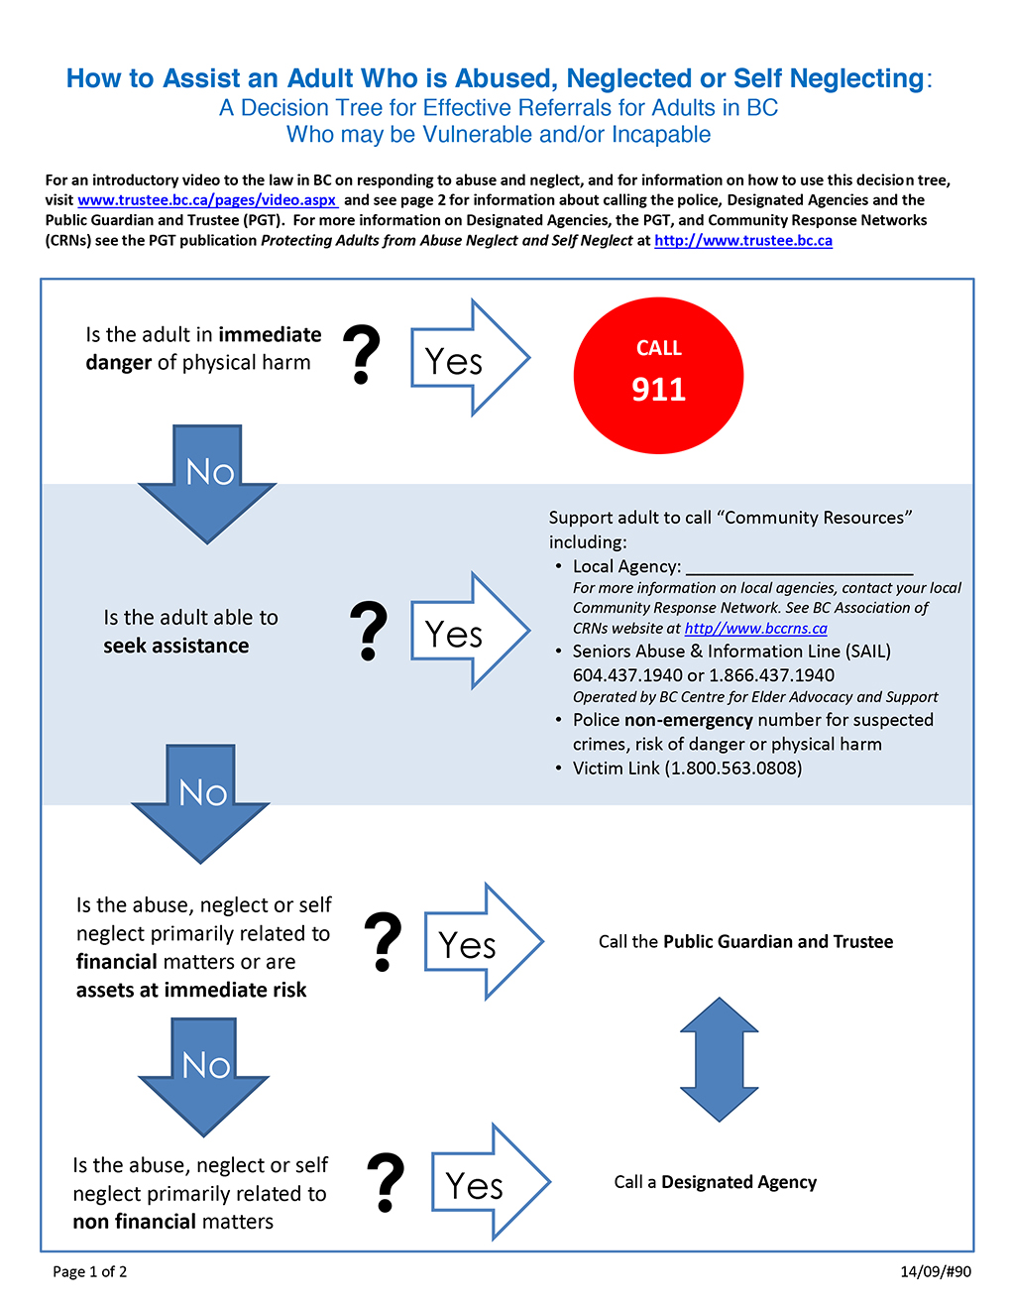
The Decision Tree

Slide 149
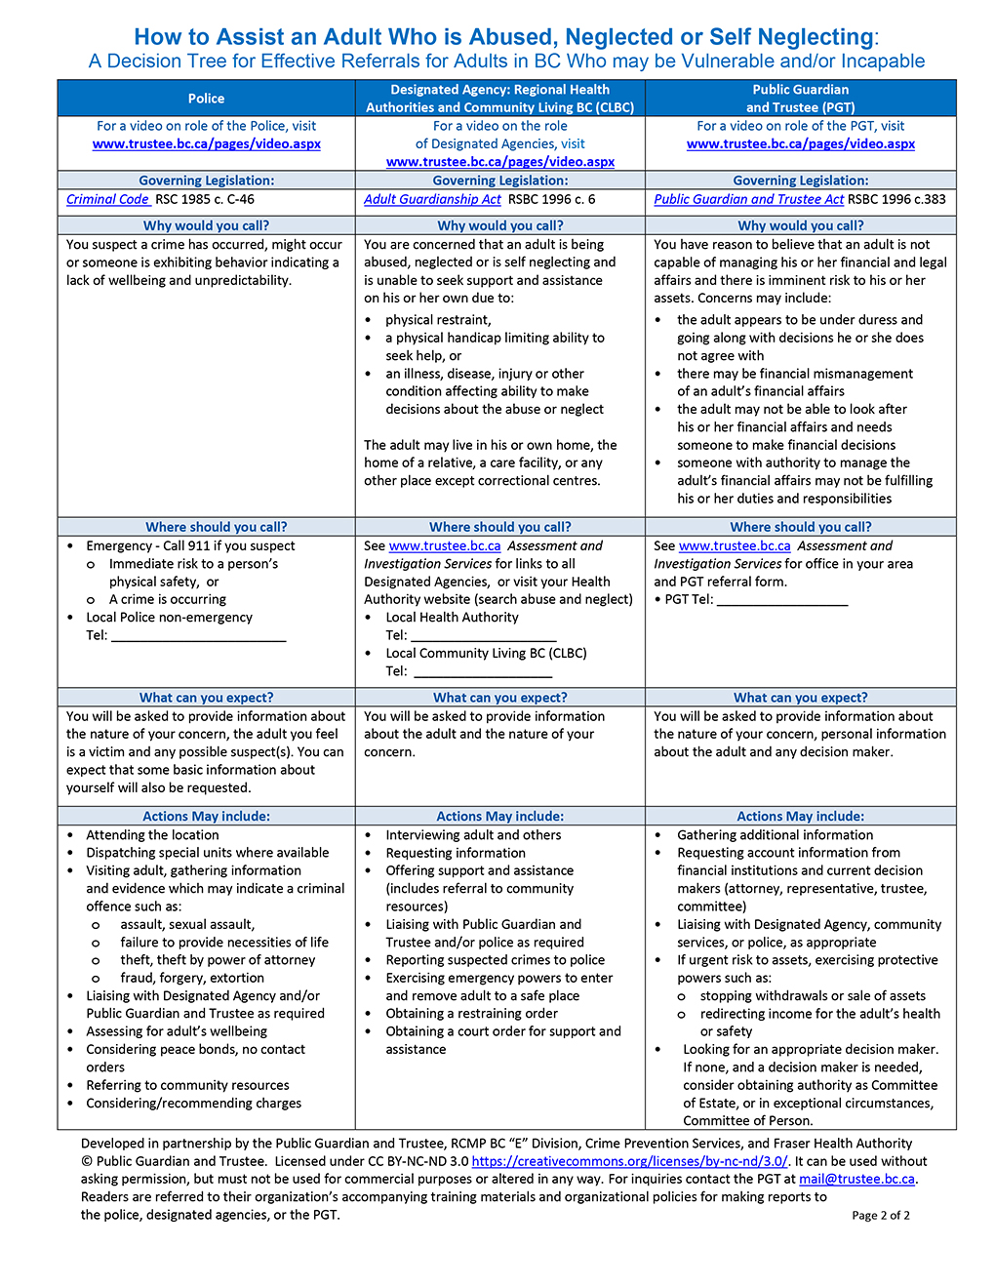
The Decision Tree

Slide 150
4.6.1 Explain professional/legal requirements for reporting
if abuse/neglect is suspected

Slide 151
Who has a legal duty to report or respond?
Designated Agencies have a duty to investigate the reports that they receive.
If it is not within an individual’s role to officially respond (some Designated Agencies have identified positions), others working in the same DA must forward the concern to a designated responder.
Operators of licensed care facilities must report abuse and neglect as a critical incident to a licensing officer.

Slide 152
Designated Agencies
Regional Health Authorities.
Providence Health Care Society (for adults who are patients or persons in care at hospitals or facilities owned and operated by Providence Health Care Society).
Community Living British Columbia (for adults in BC eligible to receive community support under the Community Living Authority Act).

Slide 153
Be aware of specific practice for your profession
Legislative requirements.
Safety protocols and policies, including for home visits.
Protocols applying to detection of warning signs.
Reporting protocols.
Profession-specific protocols.
Requirements to communicate with other professionals.
NOTE: INSTRUCTOR SHOULD IDENTIFY AND PRESENT SPECIFIC INFORMATION

Slide 154
Respond or report?
Reporting may not be possible:
  The abuse may not be of a type addressed by a reporting agency
Reporting may not be ideal:
  Other services may be needed more immediately
Reporting may not be the only appropriate response.
Reporting is not an isolated incident:
  Ongoing documentations and reports may be needed
Reporting suggests removal of older adult’s agency:
  Abuse undermines sense of personal power already

